Slide 1

Implementation of facial expressions
in Maya using Python
Author: Amro Gamal
Supervised By: Prof. Dr. Rimon Elias

Slide 2
Outline
Introduction
Problem Statement
Implementation
Applications
Complications
Amr
August 8, 2021
Bachelor Defense
Implementing facial expressions in Maya using Python

Slide 3
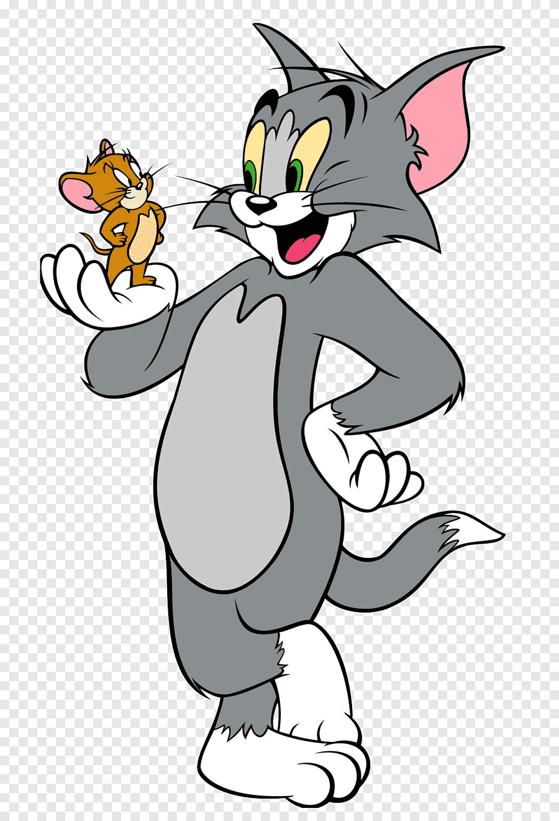
Introduction
A lot of the cartoon characters that we know and love use facial expressions.
VFX companies always emphasise on the use of facial expressions when conveying emotion.
Facial range of a 3D character is very important when designing characters.
Amr
August 8, 2021
Bachelor Defense
Implementing facial expressions in Maya using Python

Slide 4
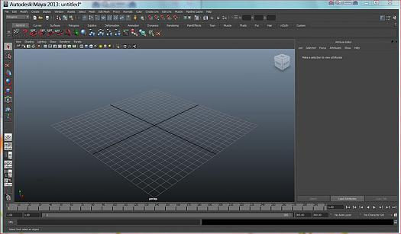
Maya interface
Amr
August 8, 2021
Bachelor Defense
Implementing facial expressions in Maya using Python

Slide 5
Maya interface(cont’d)
Maya has a lot of functionalities when it comes to working in VFX companies.
You can model, texture and rig 3D characters for you to be able to create animations.
Rigging is adding the skeleton to enable the manipulation of the 3D character you are going to use.
Amr
August 8, 2021
Bachelor Defense
Implementing facial expressions in Maya using Python

Slide 6
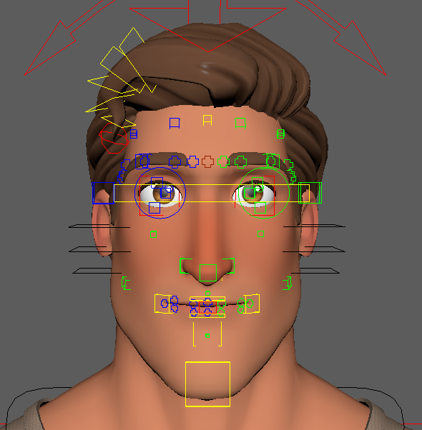
How to make facial expressions?
Creating facial expressions is through the rig provided with the character.
The rig is basically made up of several control nodes that are represented as boxes.
Manipulation of these control nodes basically creates a facial expression.
Manipulations happen in 3D space.
Amr
August 8, 2021
Bachelor Defense
Implementing facial expressions in Maya using Python

Slide 7
Keyframing animation
Creating facial expressions doesn’t animate them.
You use the key framing method provided in Maya to animate.
Keyframing is taking a snapshot of an object’s attributes at a specific point in time.
Keyframing facial expressions is saving a different facial expression at each point in time.
Amr
August 8, 2021
Bachelor Defense
Implementing facial expressions in Maya using Python

Slide 8
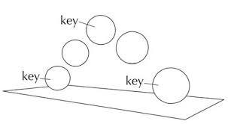
Keyframing animation
Amr
August 8, 2021
Bachelor Defense
Implementing facial expressions in Maya using Python

Slide 9
Problem Statement
Time is crucial when working in VFX companies.
It takes a much longer time to create one minute of animations relative to one minute of real life filming
You create several facial expressions and keyframe each and every single one.
A lot of time is wasted when re-doing a sequence of facial expressions.
Amr
August 8, 2021
Bachelor Defense
Implementing facial expressions in Maya using Python

Slide 10
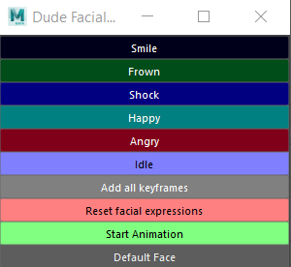
Implementation
Amr
August 8, 2021
Bachelor Defense
Implementing facial expressions in Maya using Python

Slide 11
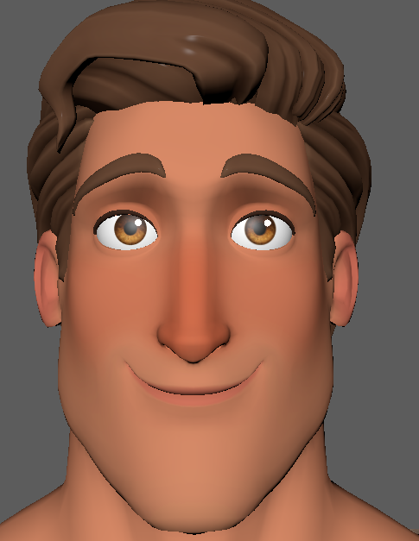
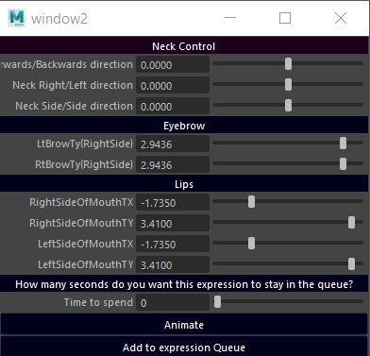
Smile Expression
Amr
August 8, 2021
Bachelor Defense
Implementing facial expressions in Maya using Python

Slide 12
Modifying smile
The user might not like the default given facial expression.
The user is given the ability to modify facial expression to his liking.
The user can manipulate the eyebrows and smile degree for example.
Amr
August 8, 2021
Bachelor Defense
Implementing facial expressions in Maya using Python

Slide 13
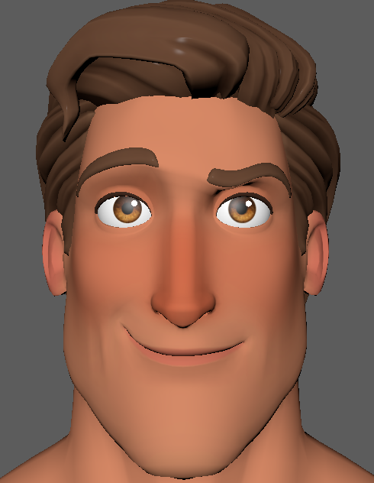
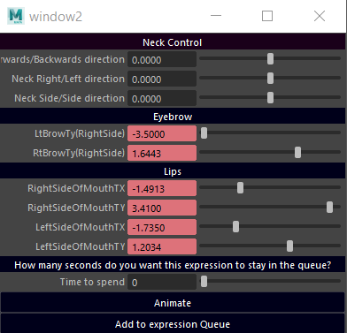
Modified Smile Expression
Amr
August 8, 2021
Bachelor Defense
Implementing facial expressions in Maya using Python

Slide 14
Animated Expression
Amr
August 8, 2021
Bachelor Defense
Implementing facial expressions in Maya using Python

Slide 15
10 second quick demo.
Amr
August 8, 2021
Bachelor Defense
Implementing facial expressions in Maya using Python

Slide 16

A fun take on this script
A teacher might want to teach his kids english.
Listening to dialogue might seem boring to kids therefore they might pay no attention.
How about adding a visual representation using this script to make it easier?
Amr
August 8, 2021
Bachelor Defense
Implementing facial expressions in Maya using Python

Slide 17
Complications and possible improvements
A good PC is needed when working in the visual effect industries.
A scenery could be added as a personal preference by the user.
More facial expressions can be implemented using the same method provided in the script.
Amr
August 8, 2021
Bachelor Defense
Implementing facial expressions in Maya using Python

Slide 18
